Slide 1
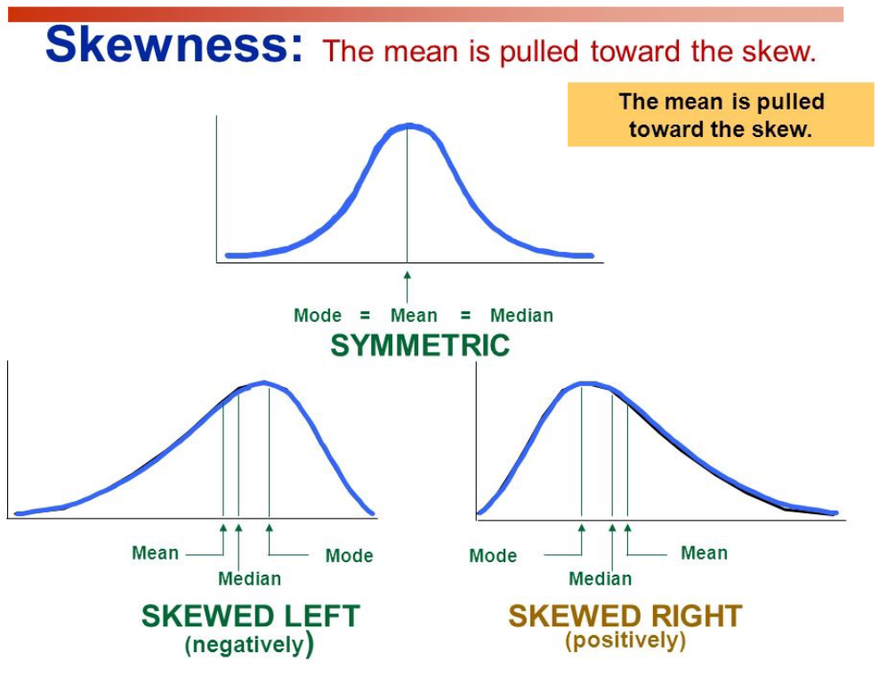
Central Tendency
Mean is affected by outliers
Median is not affected by outliers
One way to tell skew is comparing mean to median
See how mean goes towards tail?
Outliers are in the tails.

Slide 2
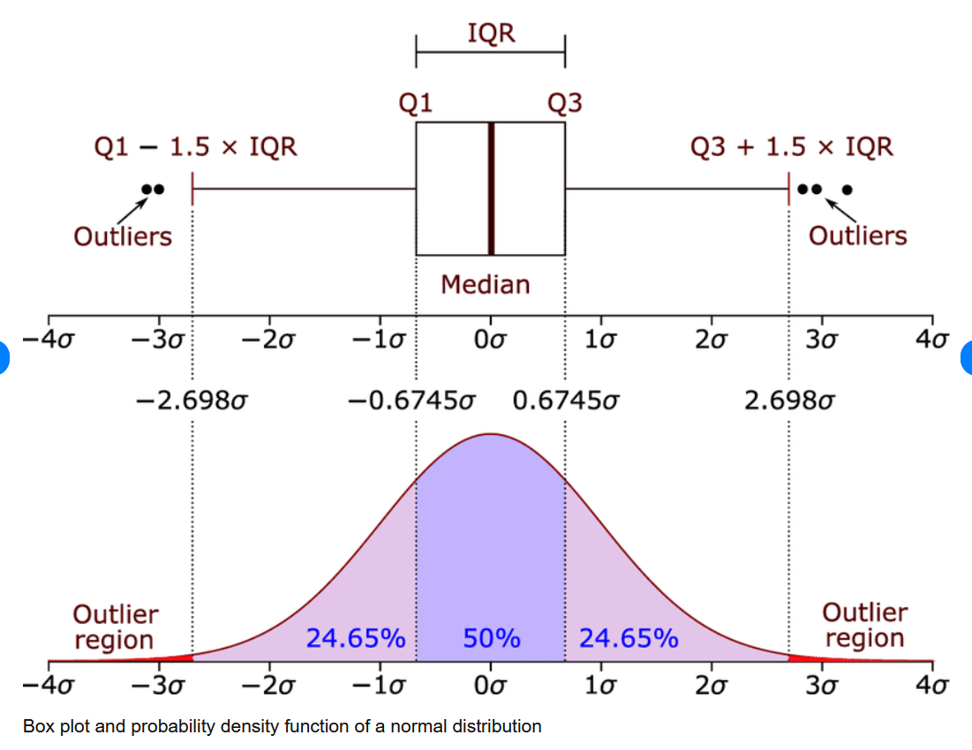
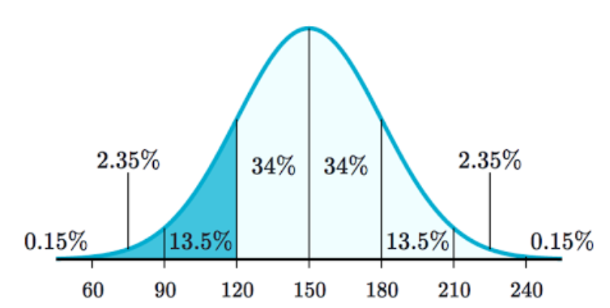
Box Plots + SD
Q2 is the median and the split point of data set
If median is closer to Q3 or Q1 it is skewed to that side.
IQR is where most of the data lives
IQR = Q3 – Q1
Whiskers are calculated to be thresholds for outlier data
Standard deviations is a single calculated value for a single unit of spread. SD is in the unit of the data set.

Slide 3
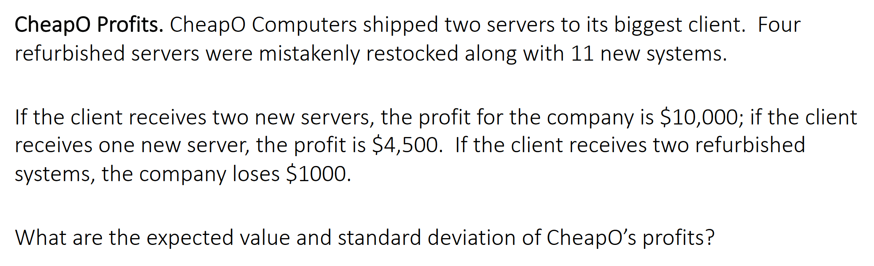
Expected Value + Return Volatility

Slide 4
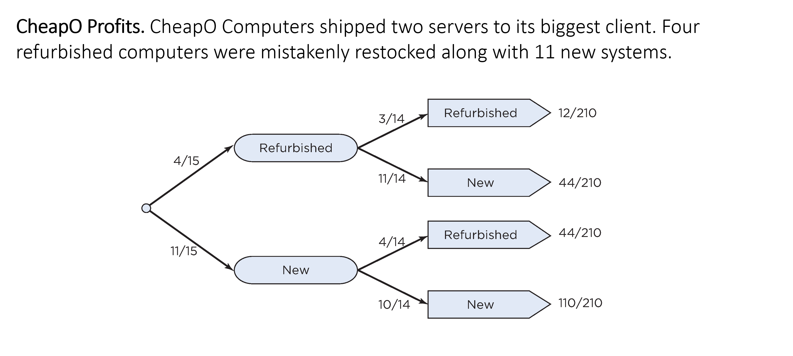
Expected Value + Return Volatility

Slide 5
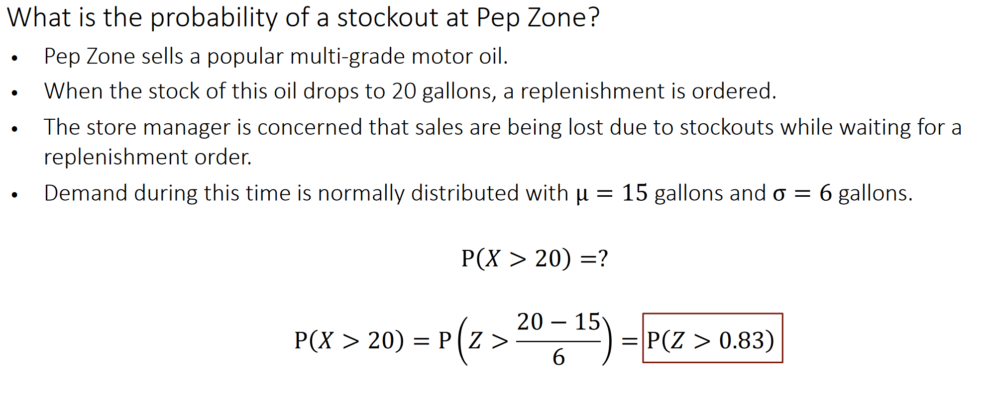
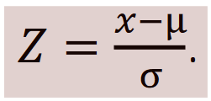
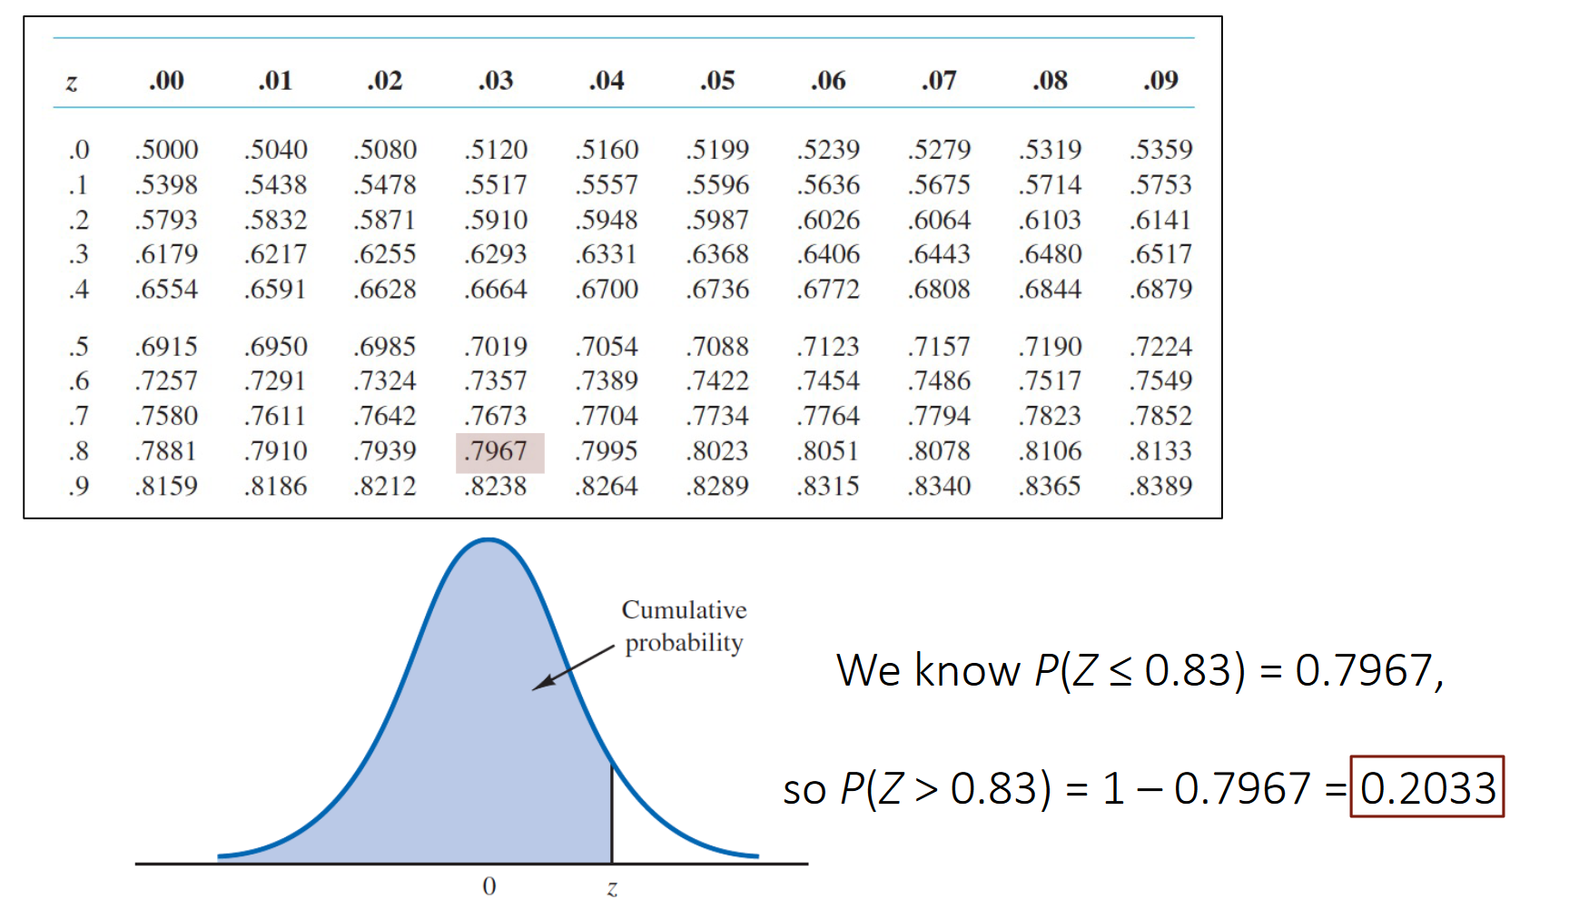
Z-Scores and Probability
Z Score is a standardized distance away from mean
Probability is the area under the curve stopping at the Z Score threshold
In example on left
Z Score is .83 (less than 1 std dev)
Area under the curve is .79
Given this data
80% prob won’t be stockout
20% prob there will be
80%
area
Value in gallons - 20
Z Score Thresh - .83
20% area

Slide 6
Covariance and Correlation

Slide 7
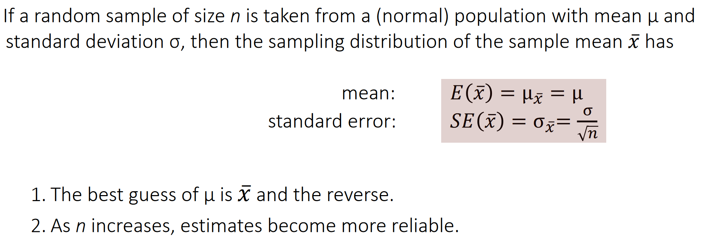
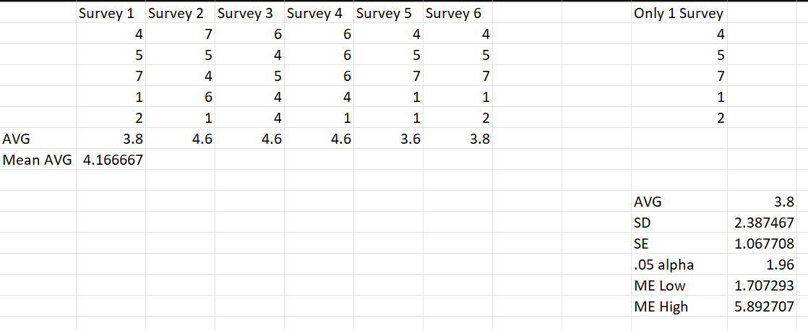
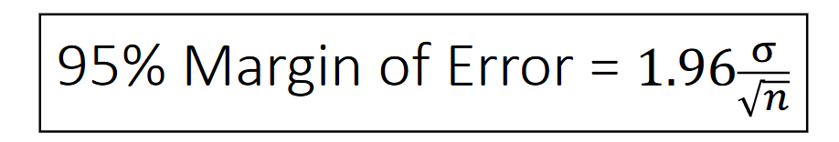
Sample Standard Error and Margin of Error

Slide 8
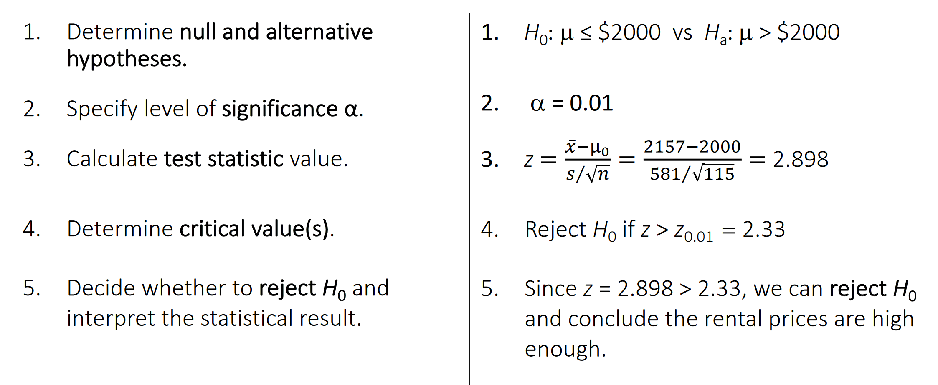
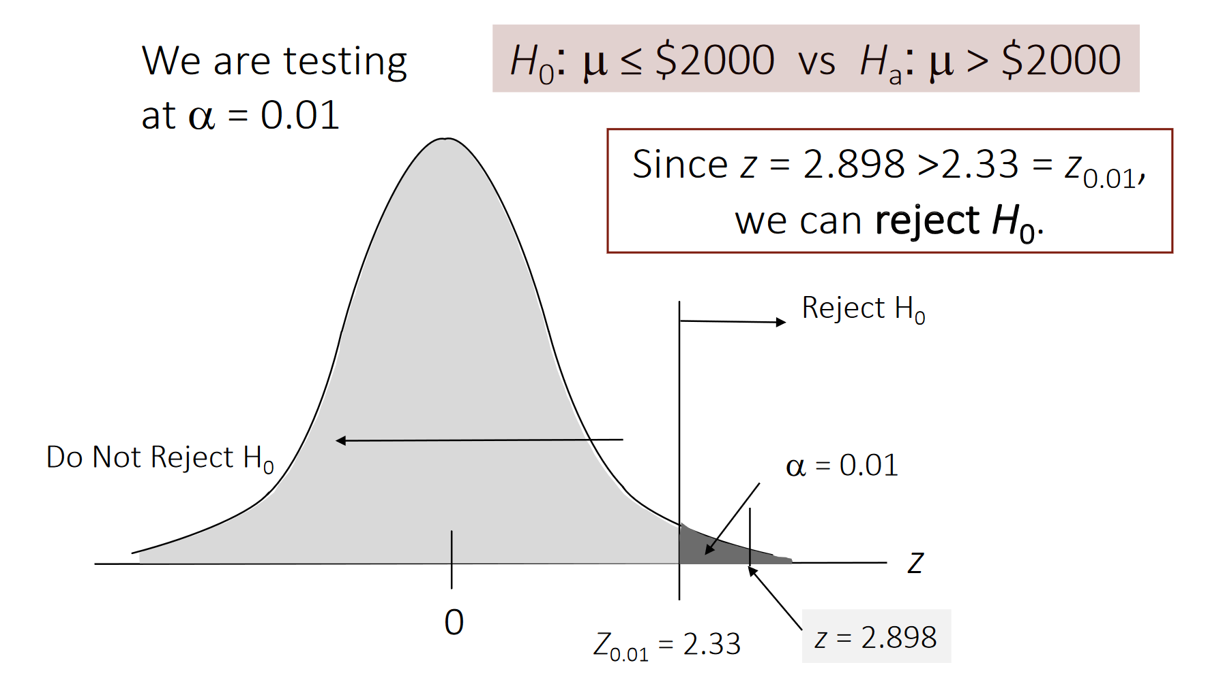
T Test
NOTE! SE is used when calculating Z Score for a sample
s/sqrt(n) = Standard Error
This distribution is null hypothesis distribution
This is where we found our sample to be
How is it that with our null hypothesis we were able to obtain a sample like we did?

